Slide 1
Fake News Detection using Machine Learning

Slide 2
THE PROBLEM AND PROJECT GOAL
Problem
The digital age has led to an explosion of misinformation.
Manually verifying the vast amount of news content is impossible.
The public needs tools to help identify potentially fake news.
Project Goal:
To build a robust, accurate, and automated Machine Learning classifier that can distinguish between real and fake news articles with high reliability.

Slide 3
Model choice: Logistic Regression-Why logistic regression was a good choice
Performance × Speed- Works extremely well with TF-IDF (sparse, high-dimensional input)
Regularization and stability
Operational readiness: small artifacts, fast inference, probability outputs for safe thresholds and human review.
Fast to train and cheap to deploy.

Slide 4
Deliverables Cleaning dataset and feature pipeline Baseline model (Logistic Regression) Evaluation (confusion matrix, ROC, PR curve, learning curves) Saved artifacts for deployment (TF-IDF vectorizer, model .pkl)

Slide 5
Dataset (source & composition)
Datasets used:
Fake.csv and True.csv combined into new_dataset.csv without stemming
Counted the dataset’s missing values

Slide 6
New_dataset.csv contents
0 As U.S. budget fight looms, Republicans flip t...
1 U.S. military to accept transgender recruits o...
2 Senior U.S. Republican senator: 'Let Mr. Muell...
3 FBI Russia probe helped by Australian diplomat...
4 Trump wants Postal Service to charge 'much mor...
...
44893 McPain: John McCain Furious That Iran Treated ...
44894 JUSTICE? Yahoo Settles E-mail Privacy Class-ac...
44895 Sunnistan: US and Allied ‘Safe Zone’ Plan to T...
44896 How to Blow $700 Million: Al Jazeera America F...
44897 10 U.S. Navy Sailors Held by Iranian Military ...
Name: content, Length: 44898, dtype: object
Notes:
Notes: dataset is roughly balanced (52.3% fake, 47.7% real).

Slide 7
Preprocessing pipeline
Merged the news title, text and, subject into a new feature 'content’
Concatenate fields: provides more signal (title + article + subject).
Lowercase & removed non-letters: reduces noise and normalizes tokens.
Stopword removal (NLTK stopwords): eliminates common words that carry little discriminatory power.
Stemming (PorterStemmer): reduces inflectional forms (e.g., “running”→“run”) to reduce feature sparsity.
Save stemmed dataset to stemmed_dataset.csv for reproducibility.

Slide 8
Example of preprocessing outputs
Example of printed English stopwords
['a', 'about', 'above', 'after', 'again', 'against', 'ain', 'all', 'am', 'an', 'and', 'any', 'are', 'aren', "aren't", 'as', 'at’, 'be', 'because', 'been', 'before', 'being', 'below', 'between', 'both', 'but', 'by', 'can', 'couldn', "couldn't", 'd', 'did', 'didn', "didn't", 'do', 'does', 'doesn', "doesn't", 'doing', 'don', "don't", 'down', 'during', 'each', 'few', 'for', 'from', 'further', 'had', 'hadn', "hadn't",...]
Example of Example of stemmed content (first rows):
0 u budget fight loom republican flip fiscal scr...
1 u militari accept transgend recruit monday pen...
2 senior u republican senat let mr mueller job w...
3 fbi russia probe help australian diplomat tip ...
4 trump want postal servic charg much amazon shi...
...
44893 mcpain john mccain furiou iran treat us sailor...
44894 justic yahoo settl e mail privaci class action...
Notes:
these classic NLP steps reduce vocabulary size and noise, improving signal-to-noise for the TF-IDF representation and simplifying model weights.

Slide 9
Feature Engineering: TF-IDF
Why TF-IDF?
Captures importance of terms relative to corpus frequency (downweights very common words and boosts rare terms).
Produces a sparse numeric matrix suitable for linear models.
Fast and effective baseline for text classification tasks

Slide 10
Training & saved artifacts
Artifacts saved:
TF-IDF vectorizer → tfidf_vectorizer.pkl
Trained model → fake_news_detector.pkl

Slide 11
Evaluation metrics
Why these?
Together they give a robust view: accuracy for overall correctness, precision/recall for class-wise performance (important for fake news), ROC/PR for threshold-independent quality, and learning curves for diagnosing under/overfitting.
Accuracy (train & test)
Precision, recall, F1 (via classification_report / specific metrics)
Confusion matrix (visualized with seaborn heatmap)
ROC-AUC (roc_auc_score + ROC curve)
Precision-Recall curve + Average Precision
Learning curves (learning_curve) to inspect bias/variance with increasing training size
Distribution of predicted probabilities (histograms)

Slide 12
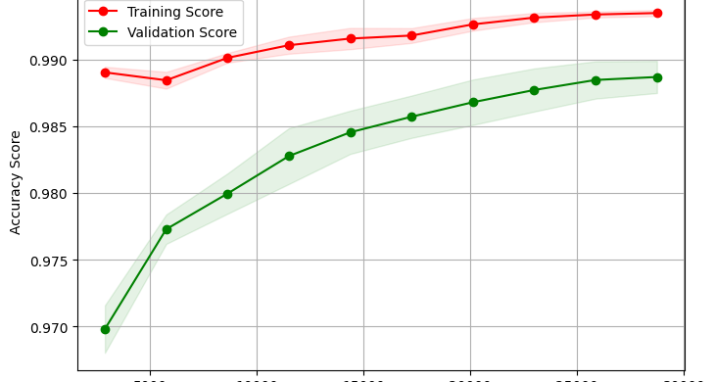
Provided outputs from our run: learning curve
Notes:
If train >> val: overfitting (need regularization, more data, or simpler model)
If both low & close: underfitting (need more complex model or richer features)

Slide 13
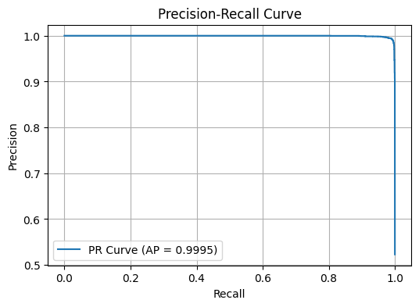
Provided outputs from our run

Slide 14
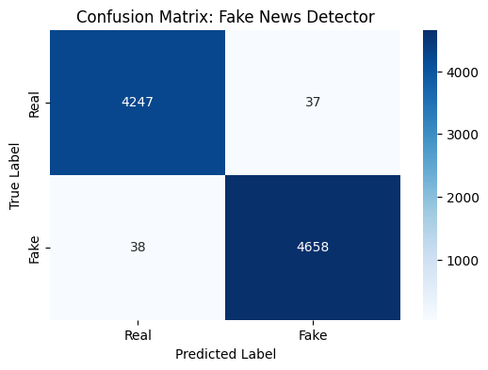
Provided outputs from our run
Notes:
Confusion matrix: We looked for low false negatives since we prioritized catching fake news (recall) and low false positives since we also prioritized avoiding false alarms (precision).

Slide 15
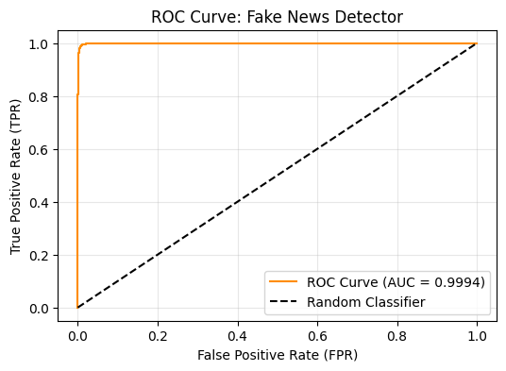
Provided outputs from our run

Slide 16
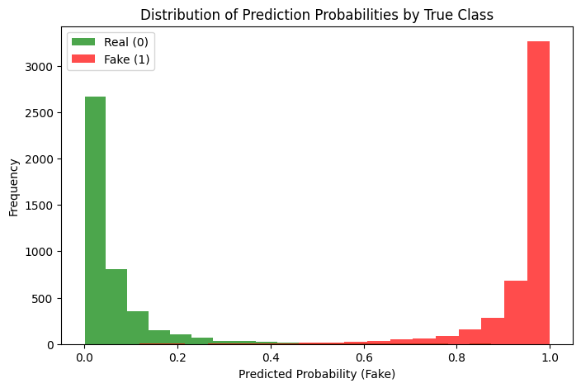
Provided outputs from our run

Slide 17
Deployment plan
Bundle tfidf_vectorizer.pkl and fake_news_detector.pkl into a small service using FastAPI.
API flow: client sends article → preprocessing pipeline → vectorize → model.predict_proba → return probability and explanation tokens.

Slide 18
Thank you
DEMO and Q&A

